Slide 1
Real-time Facial Expression Recognition for Mental Health Monitoring
Lamia Abdallah 83614
Sara alqassab 86607

Slide 2
Introduction
In recent years, there has been a notable surge in interest surrounding facial expression recognition especially in its potential applications across various industries.
This interest is pronounced in the realm of mental health monitoring, where real-time facial expression recognition holds immense promise.
The challenge lies in accurately interpreting facial expressions in real-time which is crucial for providing timely intervention and support to individuals experiencing mental health concerns.

Slide 3
Problem Statement
Creating a system that can spot emotions in real-time for mental health monitoring is tough because it needs to catch tiny facial signals accurately. Plus, we have limited resources. We'll need smart computer programs and careful testing to make sure it actually works and can be used easily.

Slide 4
Literature Review
Paper 1: Real-Time Facial Expression Recognition using Deep Learning Models: This paper presents a real-time facial expression recognition system utilizing deep learning models, including convolutional neural networks (CNNs) and recurrent neural networks (RNNs). The system achieves high accuracy in detecting and categorizing facial expressions, making it suitable for applications in mental health monitoring and emotional analysis.
Paper 2: Deep Facial Emotion Recognition for Mental Health Assessment : (International Conference on Machine Learning) This paper introduces a deep facial emotion recognition framework tailored for mental health assessment purposes. By leveraging attention mechanisms and transfer learning, the system can accurately identify emotional states in real-time providing valuable insights for early intervention and support in mental health concerns.
Paper 3: Real-time Facial Expression Analysis for Early Detection of Anxiety and Depression: This paper presents a real-time facial expression analysis system focused on early detection of anxiety and depression symptoms. By incorporating graph convolutional networks (GCNs) and multimodal fusion techniques, the system demonstrates robust performance in identifying subtle emotional cues indicative of mood disorders, offering potential for proactive mental health interventions.

Slide 5
Data Set
FER2013 (Facial Expression Recognition 2013):
The FER2013 dataset is a well-suited for projects involving facial expression recognition
1. Large-scale dataset : FER2013 contains a large number of facial images which provides
data for training and testing machine learning models. This ensures that the models have
sufficient samples to learn the complex patterns associated with different facial expressions.
2. Annotated with emotion categories: The dataset is labeled with seven emotion categories,
including anger, disgust, fear, happiness, sadness, surprise, and neutral. This annotation
provides ground truth labels for each image, enabling supervised learning approaches where
models can learn to associate facial features with specific emotions.
4. Real-world application relevance: Facial expression recognition has numerous real-world
applications, including human-computer interaction, emotion analysis in social media, and
affective computing. By training on the FER2013 dataset, models can learn to recognize
emotions in faces, which can be directly applied to these practical applications.

Slide 6
Methodology
Data Collection:
Gather a diverse dataset of facial images annotated with various emotional states, including happiness, sadness, anger, fear, surprise, disgust, and neutrality.
Ensure the dataset encompasses different demographics, lighting conditions, and facial expressions intensities.
Preprocessing:
Perform preprocessing techniques such as face detection and alignment to ensure consistency and accuracy across images.
Normalize images for consistent lighting conditions and reduce noise.
Model Selection:
Evaluate different deep learning models suitable for facial expression recognition, such as convolutional neural networks (CNNs), recurrent neural networks (RNNs), or graph convolutional networks (GCNs).
Choose models capable of real-time processing and high accuracy in emotion classification.

Slide 7
Model Training:
Split the dataset into training, validation, and testing sets.
Evaluation:
Evaluate the trained models performance using the testing set, measuring accuracy, precision, recall, and F1 score.
Integration:
Integrate the trained models into a real-time facial expression recognition system, ensuring compatibility with hardware and software requirements.
Testing and Validation:
Test the integrated system in real-world scenarios
Validate the system's performance against benchmark datasets and existing techniques, ensuring its effectiveness in mental health monitoring applications.
Documentation and Reporting:
Document the entire development process, including data collection, preprocessing steps, model training, evaluation results, and deployment procedures.

Slide 8
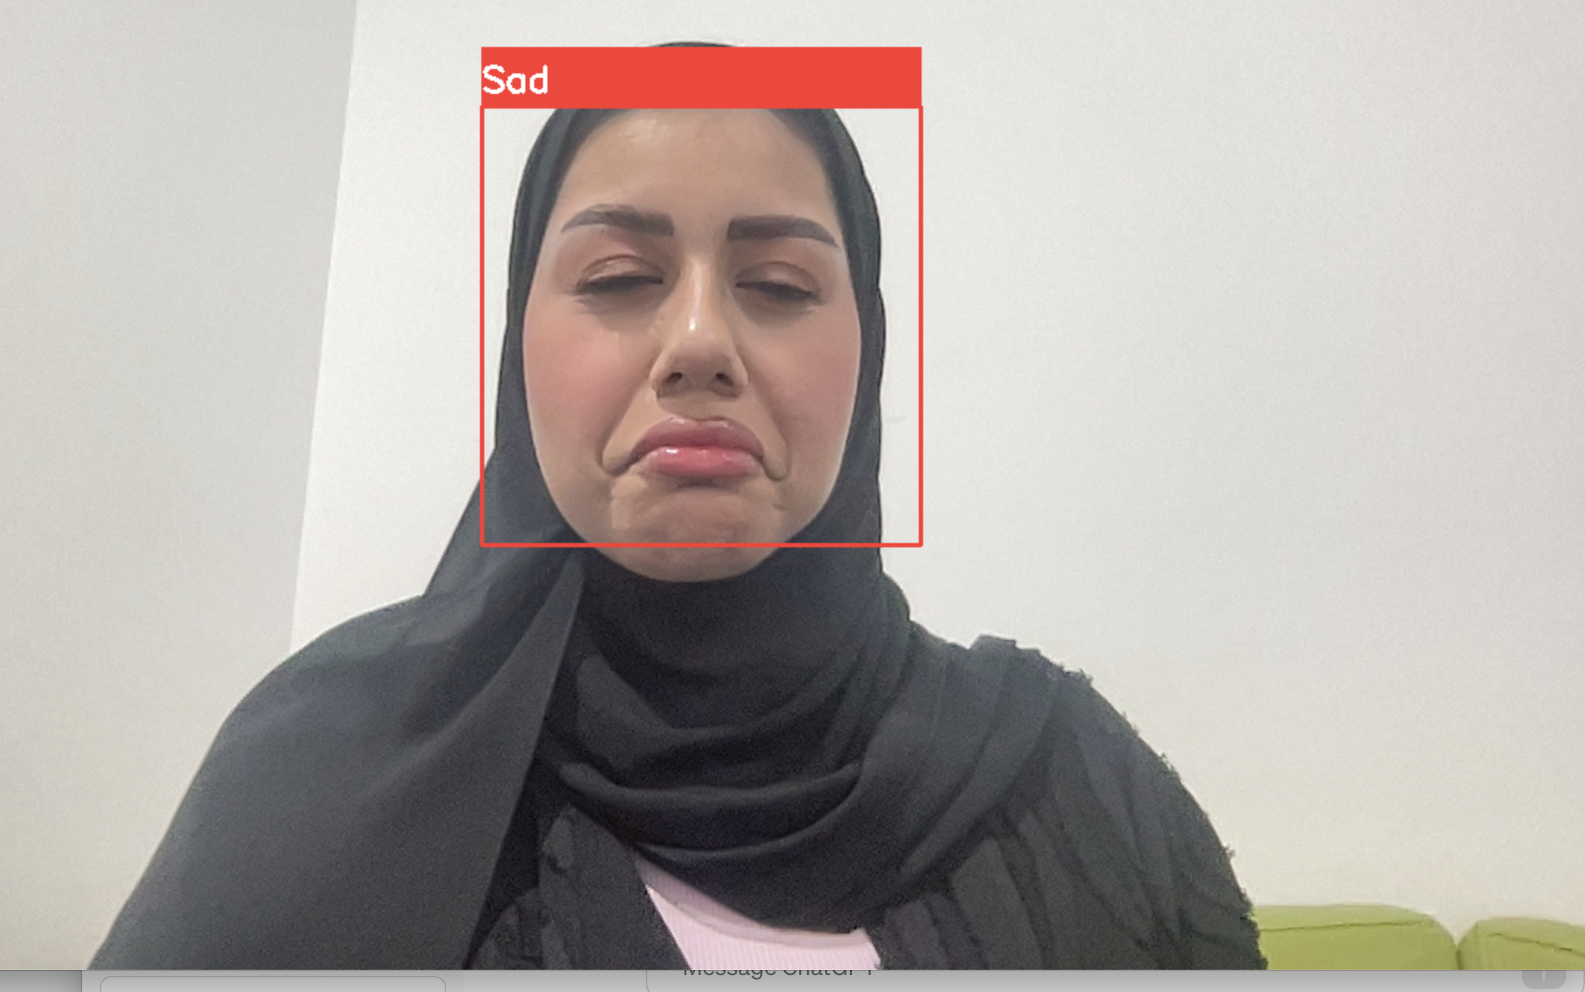
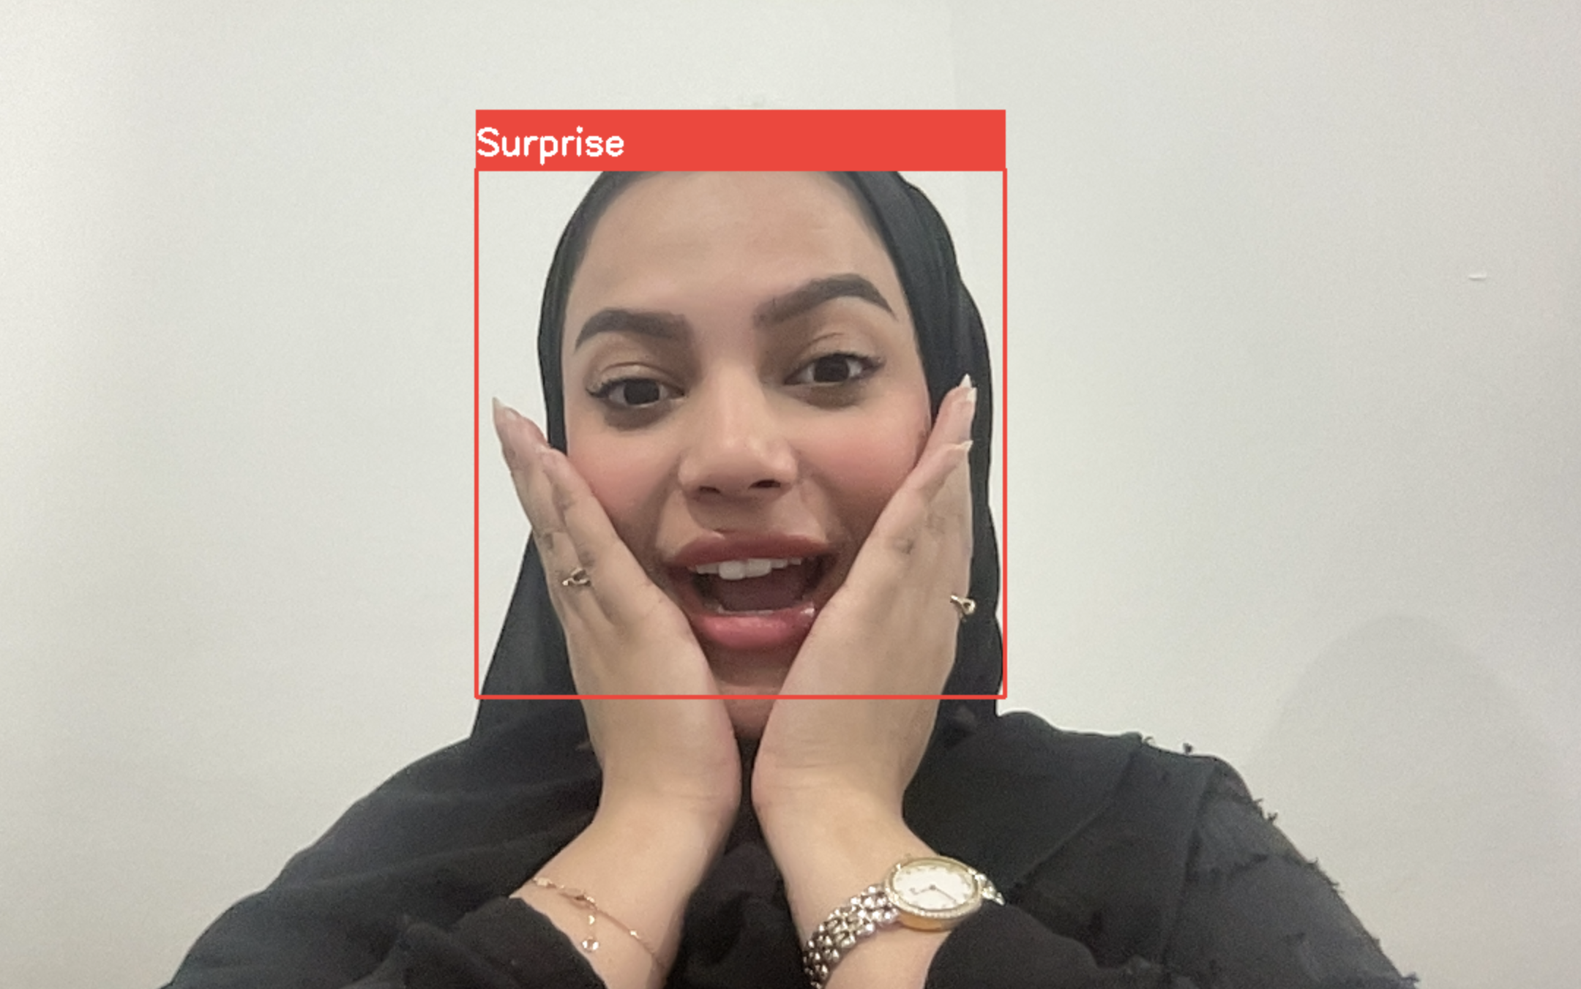
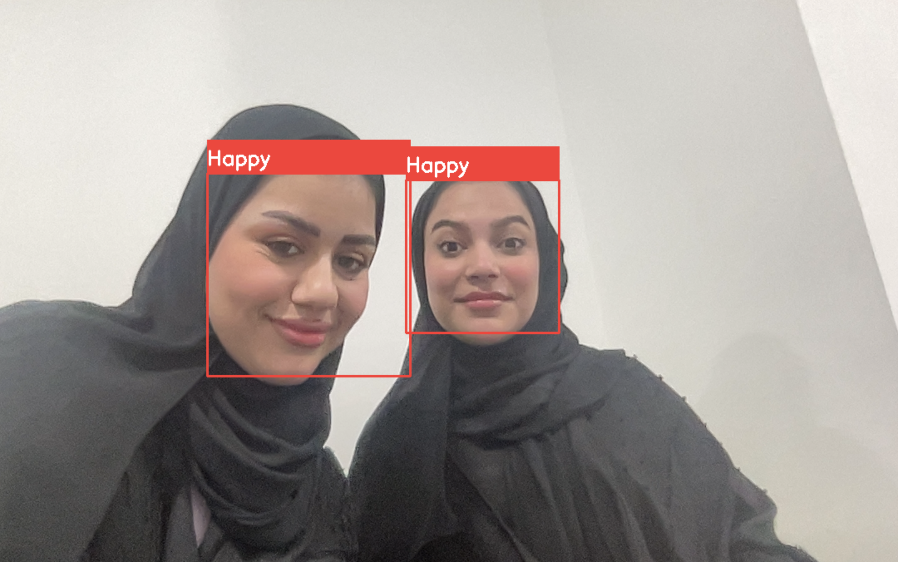
Your Results
Use additional slides as required

Slide 9
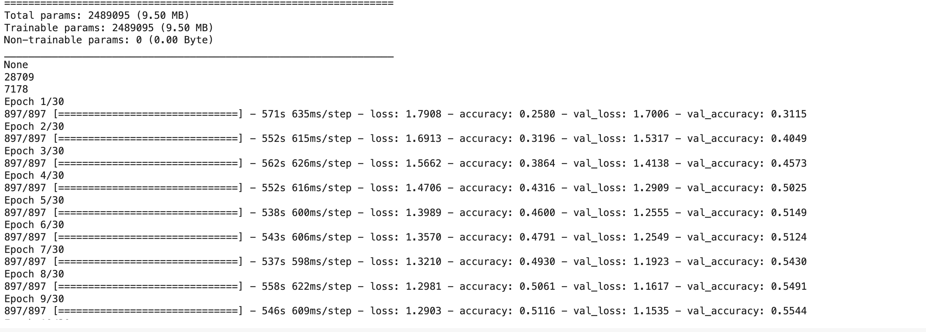
Performance evaluation

Slide 10
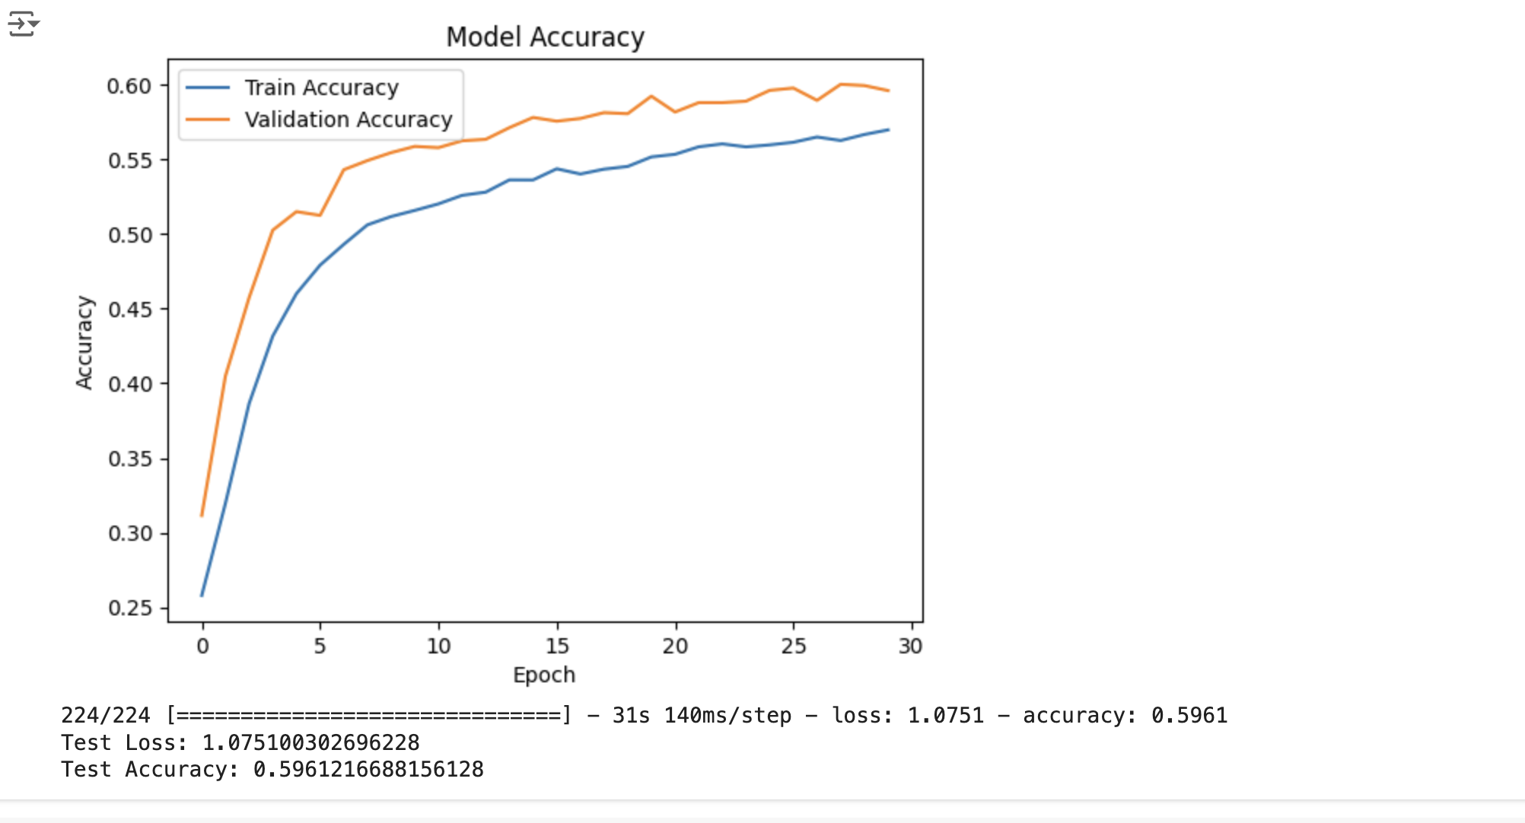

Slide 11
Demonstration
Now we will be running the code

